Slide 1

NeuroSystems Technologies Pvt. Ltd.
Experts in ecommerce, web development and web graphics

Slide 2






About NeuroSystems
3_85
Founded in 2010 by Arjun Dhar in New Delhi, India
  Specialize in Web Development and E-Commerce; we also experiment and research with new concepts
  Deliver through synergy with partner companies who specialize in Concept Design, E-Marketing
Aim on providing end-to-end service to customers, with single point of contact (see products & services)
Help includes all IT aspects related to hosting, performance, security, consulting etc. for the website
Focus on continuous innovation & learning, sharing experiences, best practices
Focus on delivering sustainable solutions that result in low long term costs and higher yield
Over Eight end-to-end projects successfully delivered to date, of which two are end-to-end eCommerce portals …and more in the pipeline
Strong belief in Work ethics. Only promise what one can commit to and build long term relations which assert Trust
If it can’t be scaled, we don’t want to do it !
Providing personal attention to customer needs, but generalizing problems and re-package it as a product solution.
We promote a disciplined & dedicated work ethic that is yet informal and innovative
Never shy of sharing our honest opinions with our customers
Some of our clients

Slide 3
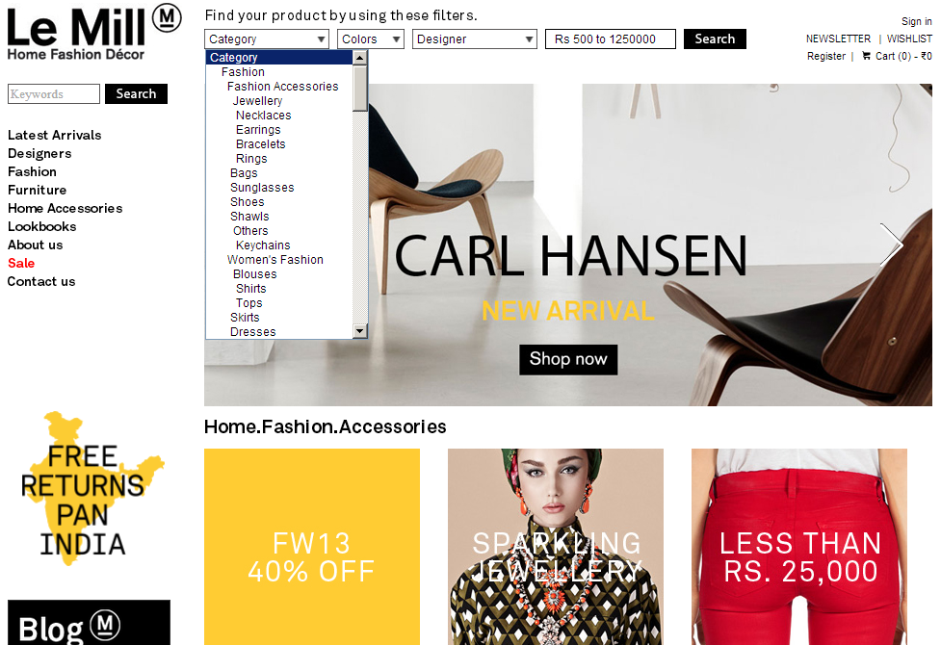
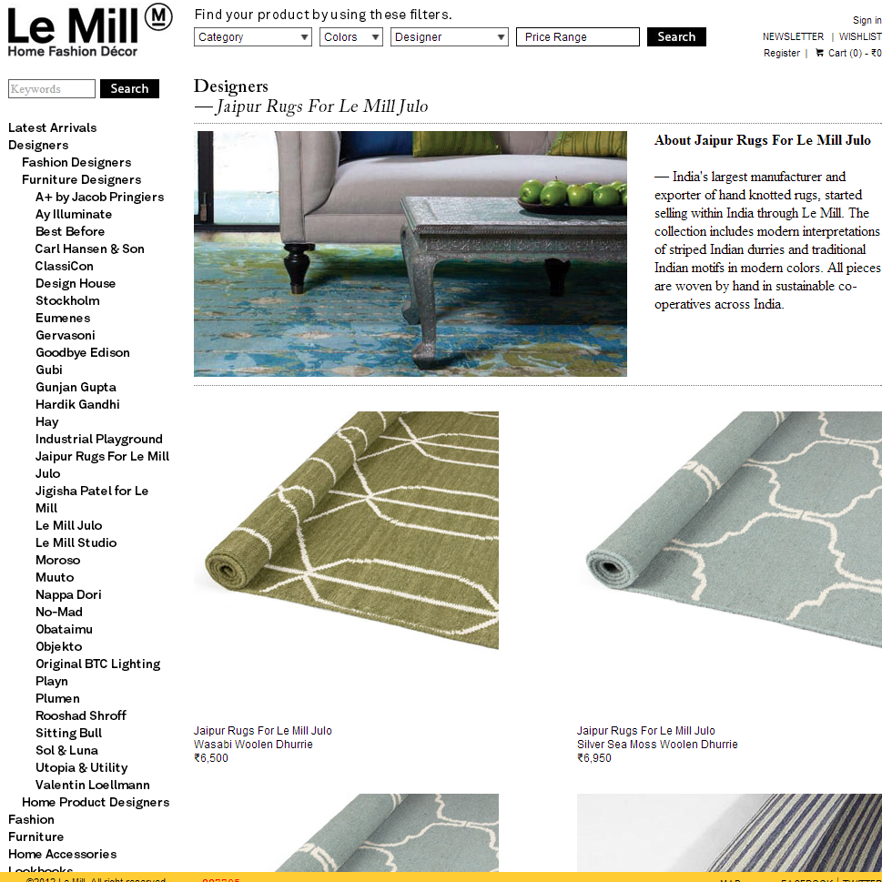
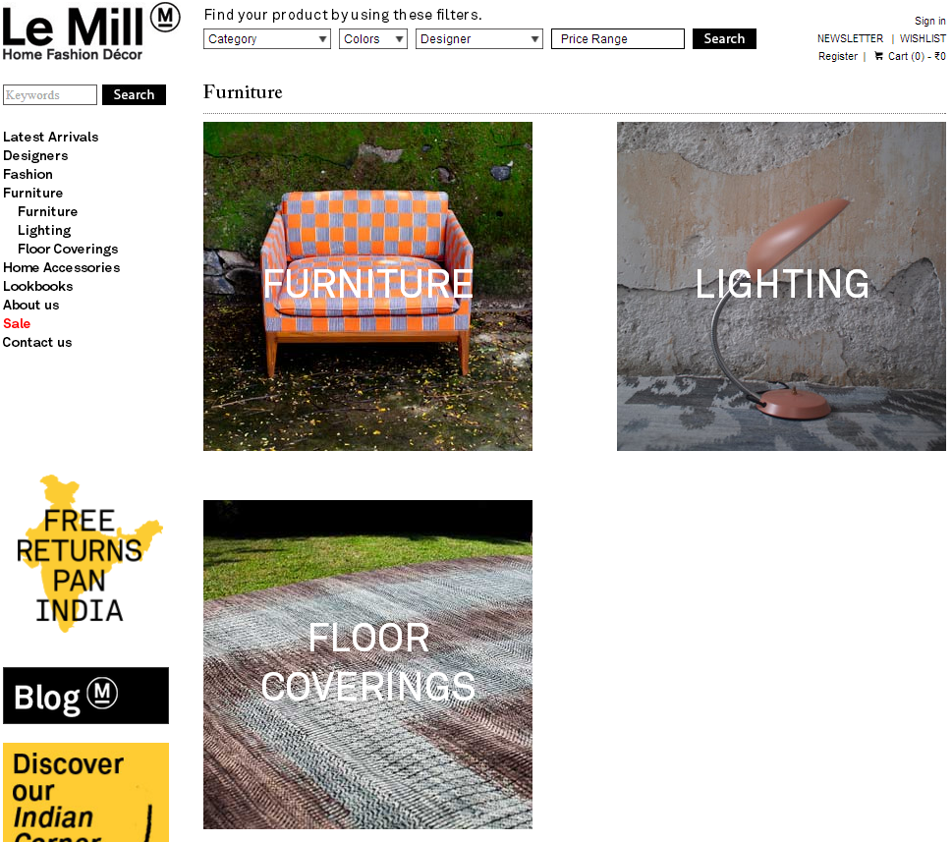
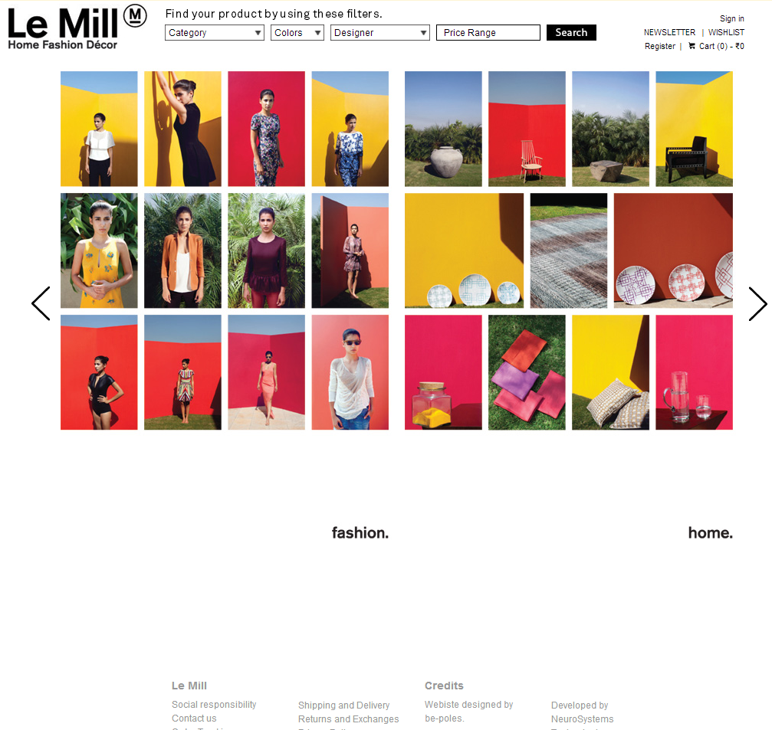
4_85
https://www.lemillindia.com
E-Commerce for Multi Brand Luxury Fashion and Furniture Designers
Powerful Search abilities, News letters
Just requires one non technical person to manage the entire site; including content, catalogue, orders; thanks to our simple to use proprietary technology
Ability to create & execute online Spot marketing Campaigns within hours
Ability to change complex Shipping policies, Discount policies, Sale policies, Payment Option policies, Tax policies with confidence
Once a feature is tested & delivered , it requires no dependence on a programmer thereby allowing business direct control which helps in reduce TIME & COST to market or change strategies
Focus on Automation and less manual interference : CMS, Direct automation, Catalog System, ETL and more…

Slide 4
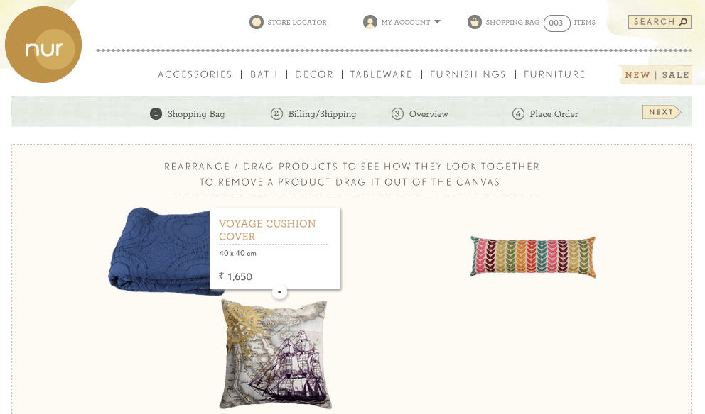
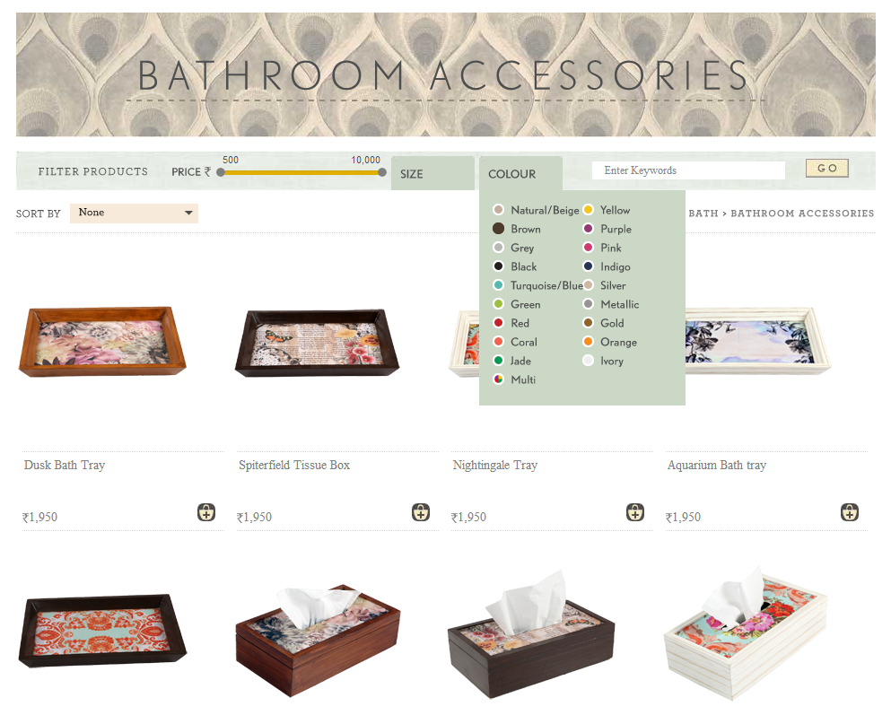
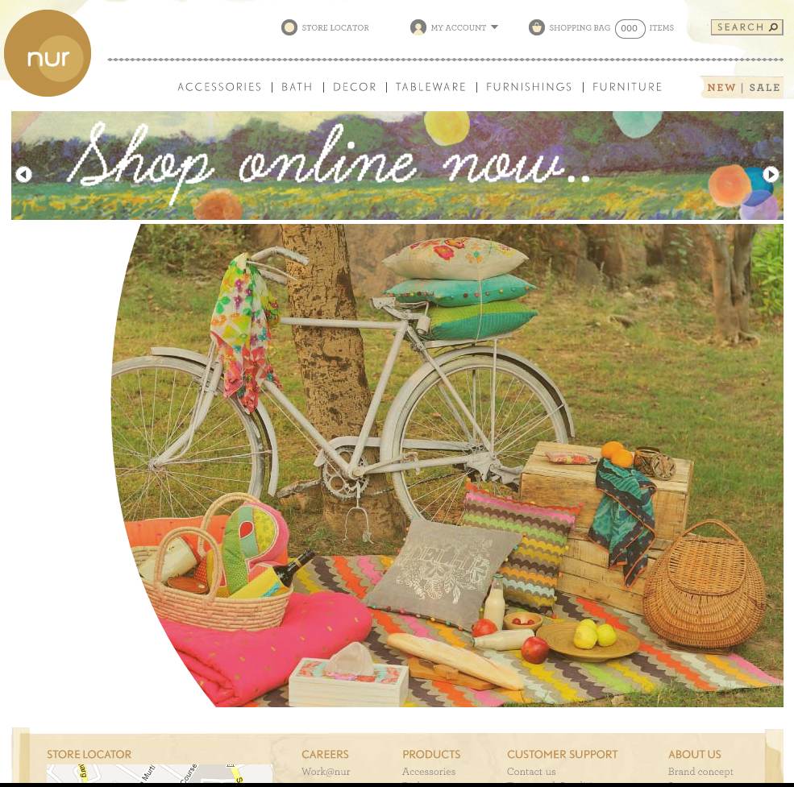
4_85
https://www.nurhome.in
E-Commerce for Multi Brand Home Furnishings Export
NON-FLASH based Animation on Home Page that allows business user to change pictures within Animation without programming
Dynamic & Visually interactive pages
Powerful Search abilities customized per category
No technical staff required to manage site
Drag and compare Visual Shopping Cart (No site in the world has this)
Ability to change complex Shipping policies, Discount policies, Sale policies, Payment Option policies, Tax policies with confidence
Focus on Automation and less manual interference : CMS, Direct automation, Catalog System, ETL and more…

Slide 5
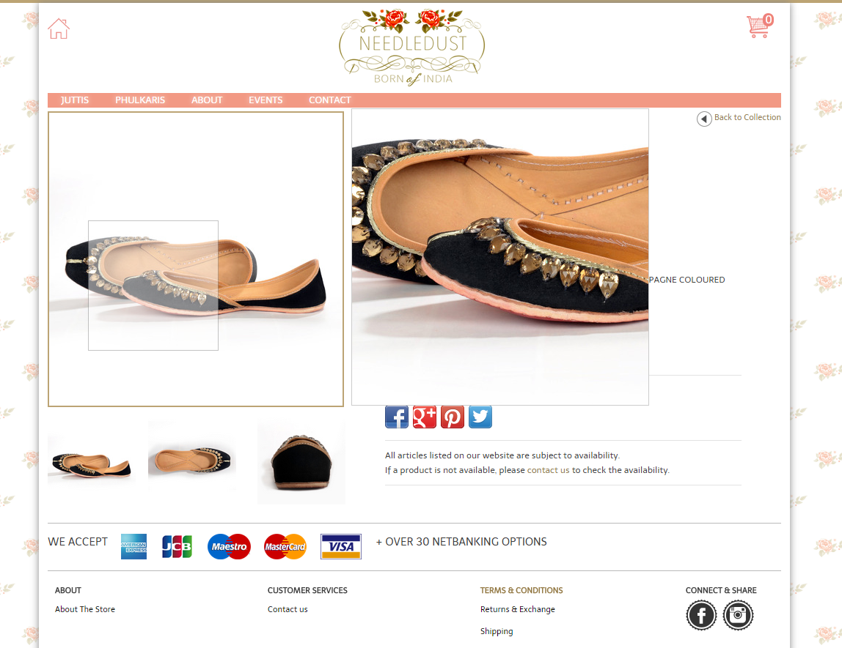
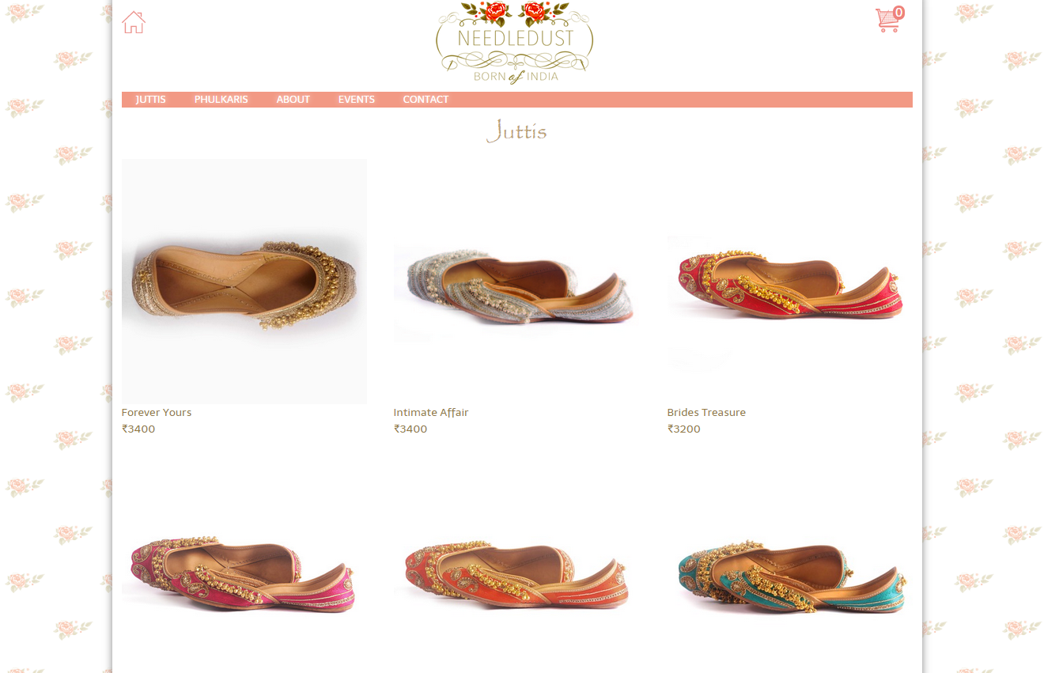
4_85
http://www.needledust.com
E-Commerce for lower budget
Aimed purely for SALE and quick user experience
Design and User Experience was done by us end to end
No technical staff required to manage site. Site is run by 1 person who is also handing the business
Focus on Automation and less manual interference : CMS, Direct automation, Catalog System, ETL and more…

Slide 6
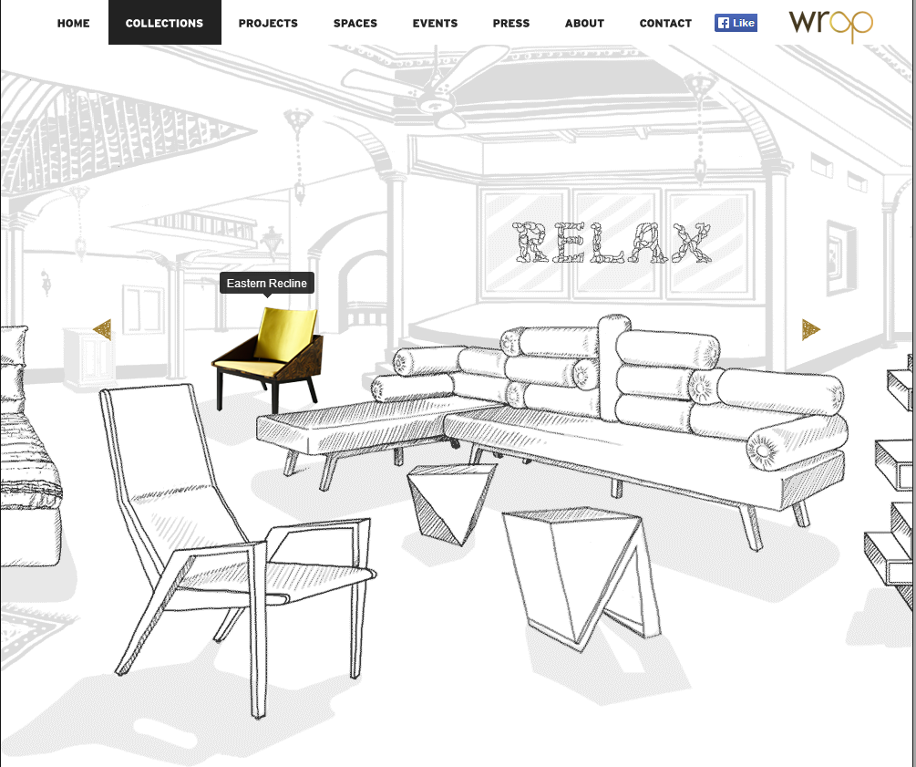

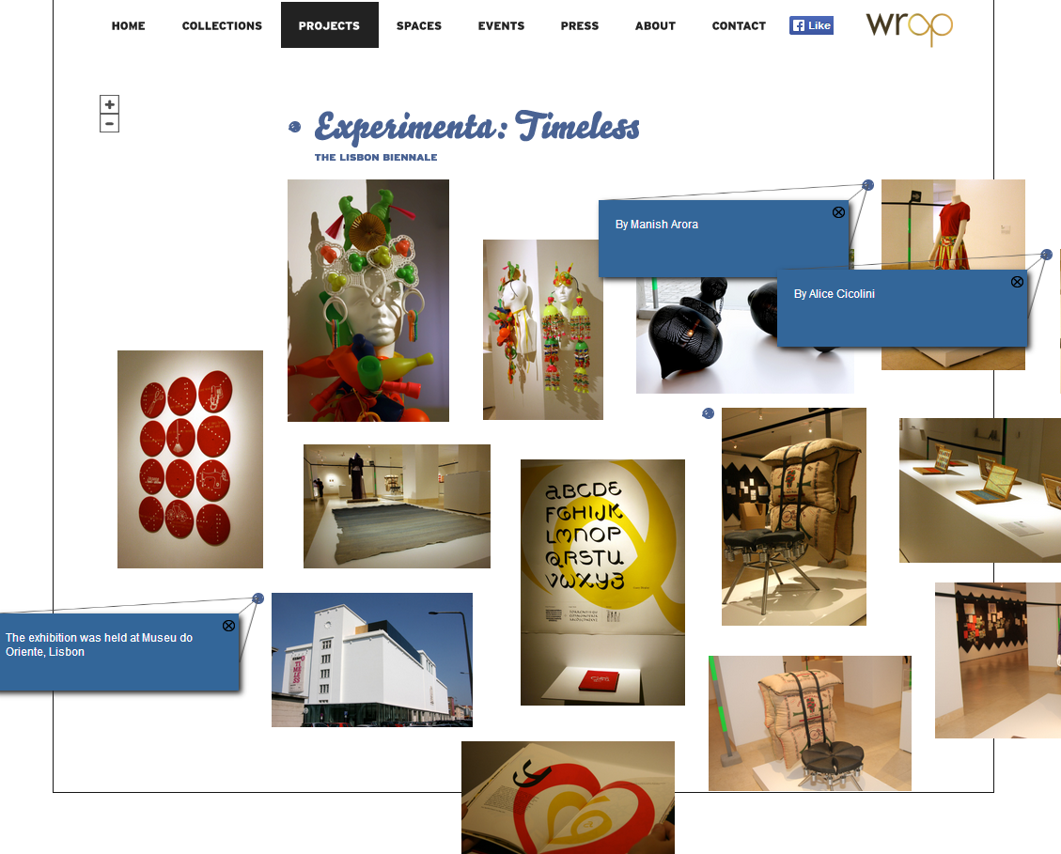
4_85
http://wrap.co.in
Brand identity and Product catalogue for Design Company
Each page on Site has a unique design concept
Home page background image changes each time you visit the site
NON Flash based visually interactive pages
Has a very visually appealing and interactive PRESS, Events page
Example:
On the collections page on the website, one can interact with their Products in 3D.
On interaction the object comes to life in colour
Map like concept of all the projects; you can Zoom in/out & interact with them

Slide 7

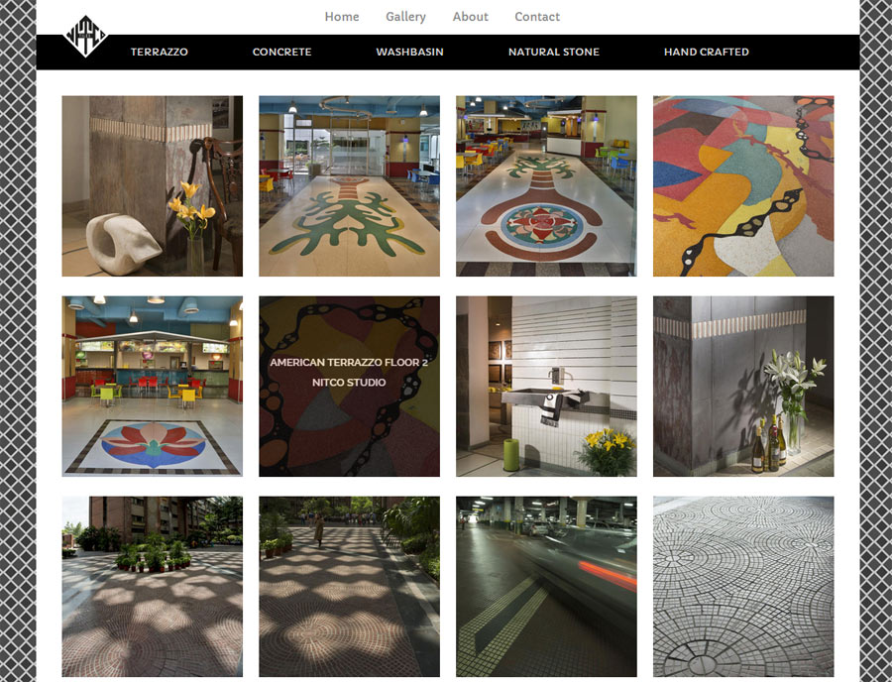
4_85
Nitco Tiles @ http://nitcotile.in/nitco/gallery.jsp
Brand identity and Product catalogue for well known Tile Company
Each category has a different theme.
NON Flash based visually interactive pages
Managed by a catalog system and backend doing all the image and data heavy lifting

Slide 8
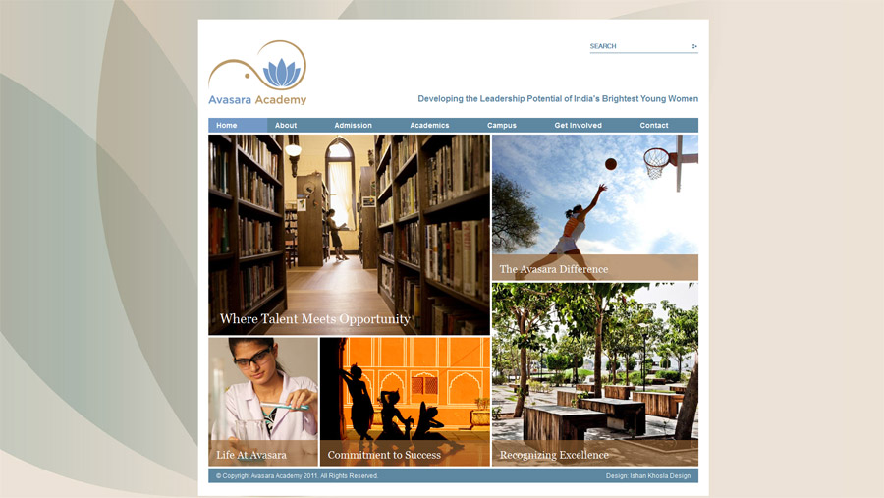
4_85
http://avasara.in
Corporate Site CMS based for an NGO promoting girl child education

Slide 9

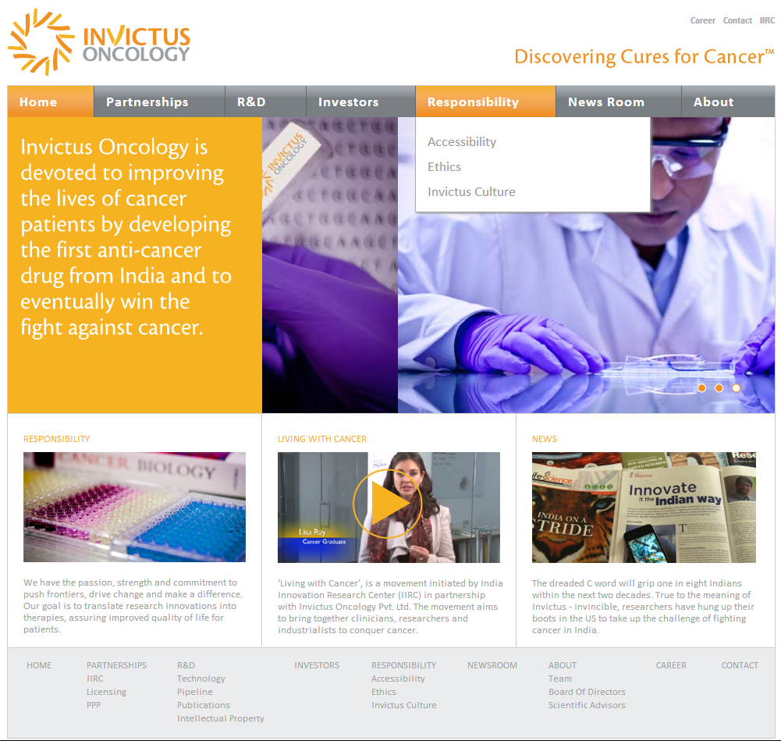
3_85
Brand Identity Site for an Oncology Research Startup
Static site based on HTML / CSS

Slide 10



… and more
3_85
Catalogue Sites
Research projects
Incubation Projects
Consulting Projects
Startup Projects
Anand Bazaar Patrika
Rajeev Agarwal Architects

Slide 11
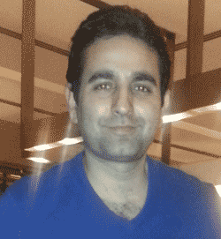

About the Founder arjun dhar
3_85
Founders Background:
  An experienced software developer and IT consultant to clients ranging from Fortune 500 companies to startups
  Over 10 years experience working with clients across US, Australia, Europe and India
  Specializes in web and business application development, including requirement gathering, design, security, development and maintenance
  Wide use of open source and proprietary technologies in Java for development
  Education :
    Masters in Computer Applications (MCA) from Visva-Bharati University India,
    Course in Digital Marketing from DSIM Delhi and certification from Google (in pursuit)
    Certification in Computer Application Security from OWASP
    Research assistant in computer in research paper for Neural Nets Vs Logistic Regression at IIM (Calculatta, India),
    Bachelors in Science from Delhi University and a diploma; GNIIT from NIIT,
    Computer Science background + Programming enthusiast since 1988
    Misc Certifications & Trainings : Six Sigma Process Certification, Database SQL Certification
  Specializes in Web Development for Business needs and E-Commerce; using Java Platform
  Consultant to other software organizations and projects
  Active participant of many software open source projects
  A well balanced mix of experience that ranges in working with Organized environments to chaotic ones
  Technical Lead on projects in several organizations
  Winner of multiple awards during employment tenure

Slide 12
Full suite of products & services
Web solutions
Website design & user experience | Technology partner to leading website designers in India, bringing together creative and technical aspects that enable superior user experience on the web
Website development | Implementing web design, to create static or dynamic websites, with full array of optional custom functionalities
E-Commerce | End-to-end portal and ecommerce site development, with integrations such as payment gateway and cloud services etc. Include: Powerful and flexible Search, Tracking, Orders & Invoicing, Advanced Cart features, Flexible Reporting, Promotions & Discounts, Mailing using customized templates and more.
Web security consulting | Expertise in protecting websites and applications on the web against hackers
Web service development | Services on websites to enable mobile application development
Website hosting | Manage entire website set-up including hosting through third-party infrastructure providers
Document management & image processing | Allow centralized repository of document versioning and workflow management
Specific Business application development | Create custom business solutions to fulfill a specific need (eg. creating an invoicing system, partnership incentive model, custom development on salesforce.com etc)
E-Marketing (SEO) | Technology partner to leading social media and web marketing experts that can help attract higher traffic; bulk promotions mailers and newsletters
Cloud development with Amazon, SalesForce, Google | Leverage existing cloud services that a business may have purchased, to deliver custom business solutions
Business services

Slide 13
Website links
Site: Le Mill E-Commerce
https://lemillindia.com/
Pages on site
https://lemillindia.com/home.jsp
https://lemillindia.com/designer.jsp?name=John%20Dalia
https://lemillindia.com/lookBooks.jsp
https://lemillindia.com/lookBook.jsp?name=FW13+LOOKBOOK
Site: Nur
https://nurhome.in/
Pages on site
https://www.nurhome.in/nur/category.jsp?name=Furnishings
https://www.nurhome.in/nur/catalog.jsp?name=Cushions
https://www.nurhome.in/nur/press.jsp
http://www.nurhome.in/shop-1-bag.jsp (Interactive Shopping Cart - Custom Built. Add products to cart, and play with the cart items)
Add some products and add to Cart -- No site in the World has a Shopping Cart like this and was developed from scratch by us
http://wrap.co.in/
Pages on site
http://wrap.co.in/collections.html - Interact with various Products on the Scene
http://wrap.co.in/events.html
http://www.wrap.co.in/projects/experimenta.html
Other sites:
http://avasara.in/
http://www.invictusoncology.com/
http://trueso.co.in/

